Slide 1

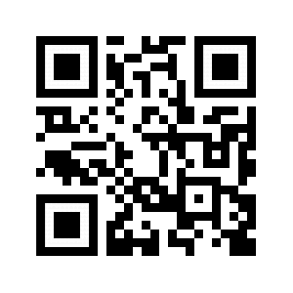
Put your main findings/points in giant text here so everyone can easily see it when they’re walking by. This way, even if they don’t want to talk or even have time to stop they’ll at least know something about your work.
Short but Descriptive Title Here
First Last^{1,2}
¹Affiliation One
²Affiliation Two
Section One (Intro/Background)
Some text here, maybe a figure or something
Another Section (More Background/Methods)
More words and pictures go here
A Third Section!? (Methods/Results)
Blah blah blah
Section Four (Results)
Try to limit text by using more plots that you can describe in person. This poster design sacrifices some of the text space of traditional posters in order to announce your key findings so it’s important to be concise
Last Section (Discussion)
And done
Contact Information
Email:
Twitter:
Acknowledgments
Poster design inspired by Mike Morrison (@mikemorrison on Twitter). A thorough description of his ideas and his original templates can be found on his Youtube video (above QR code)
Scan QR Code to view full publication:
Use QR codes to easily link to any relevant publications or explanatory materials, etc.
They’re easy to make at qr-code-generator.com
Notes:
Notes:
In Powerpoint, click View > Guides
Keep text within gutter guides.
Author list: Don’t split names onto two lines (e.g., “Jimmy [break] Smith”). If that happens, use a new line, unless you need the space. Bold the first names of anybody who’s presenting in person.
Intro/methods/result: Do not drop below font size 28, but if you have extra space, jack up the font size until the space is full.
Do not use color in the sidebars except in graphs/figures. It’ll pull attention from the center and slow interpretation for passersby.

